Slide 1
School of Computer Science Engineering and Information Systems
PMCA698J — DISSERTATION-I / INTERNSHIP-1 | REVIEW 1 | FALL SEMESTER 2026–27
Early Sepsis Prediction in Intensive Care Units Using Explainable Deep Learning and Multimodal Data Representation
Sub-brand: SepsisSense AI
Sudhanshu Kumar Jha — 25MCA0181
Under the guidance of
Dr. Sweta Bhattacharya
Professor

Slide 2
Presentation Outline
Abstract
Findings
Introduction
Novelty
Problem Statement
Methodology
Objectives
Software Requirements
Scope of the Project
Technology Stack
Proposed System
Summary
System Architecture
Conclusion & Future Scope
Literature Survey
2

Slide 3
Abstract
Sepsis is a life-threatening dysregulated host response to infection, leading to systemic inflammation and multi-organ dysfunction. Its clinical management is highly time-sensitive, making early detection and warning systems essential in critical care.
This project proposes a robust deep learning framework for early sepsis prediction. By combining structured EHR data with unstructured clinical notes (SepsisDRM-style multimodal representation), the model captures clinical context that traditional systems overlook. Temporal Convolutional Networks and a Kernel Attention Transformer (KA-Transformer) model long-range dependencies, while conformal prediction and active sensing quantify uncertainty and recommend informative measurements.
Post-hoc explainable AI (SHAP) provides transparent, feature-level rationales, bridging the gap between deep learning complexity and clinical trust. The system will be evaluated on benchmark cohorts such as MIMIC-Sepsis to ensure generalizability under distribution shift.
~20%
of all global deaths occur due to sepsis annually
7.6%
rise in mortality per hour of delayed antibiotics
6–12 hrs
advance warning targeted by this project's model
Keywords: Sepsis Prediction, Explainable AI, Deep Learning, Temporal Transformer, Conformal Prediction, Multimodal Representation.
3

Slide 4
Introduction
Scale of the Challenge
Limitations of Traditional Surveillance
Gaps in Deep Sequence Models
Sepsis accounts for roughly 20% of global deaths annually; mortality rises by up to 7.6% for every hour antibiotics and fluid resuscitation are delayed.
Widely used EHR-based ML surveillance tools score risk from vitals and labs alone, ignoring the rich clinical context captured in nursing and progress notes.
LSTMs and Transformers capture temporal patterns well, but remain black-boxes clinicians hesitate to trust without an interpretable rationale.
Single-Modality, Overconfident Alerts
Project Approach
Most systems model structured or textual data alone and rarely quantify their own uncertainty, so they alert confidently even on sparse, ambiguous cases.
This project fuses structured EHR and clinical text through a shared multimodal embedding, models sequences with a KA-Transformer, and wraps every output in conformal prediction and SHAP-based explanation.
4

Slide 5
Problem Statement
Existing sepsis prediction systems face critical challenges that limit real-world deployment: ICU time-series data is sparsely and irregularly sampled, and imputing missing values introduces uncertainty that propagates into false alerts. Sepsis cases represent a small minority of ICU admissions, so models trained on imbalanced data often suffer from low sensitivity or high false-alarm rates.
Complex architectures such as Transformers and BiLSTMs behave as black boxes, making clinicians hesitant to trust their alerts without interpretable rationales. Models trained on single-center datasets also fail to generalize across institutions due to differences in demographics, equipment, and clinical practice.
☐
A system is needed that jointly fuses structured and textual clinical data, quantifies its own predictive uncertainty rather than alerting blindly, and explains every alert — while remaining robust across different ICU sites.
5

Slide 6
Objectives
01
02
03
Hybrid Temporal Modeling
Multimodal Embedding (SepsisDRM)
Conformal Uncertainty Layer
Develop a KA-Transformer + TCN model to predict sepsis onset 6–12 hours in advance.
Jointly encode structured EHR variables and clinical notes into a shared representation space.
Integrate conformal prediction so the model can flag low-confidence patients as indeterminate instead of false-alarming.
04
05
06
Explainable AI Integration
Cross-Site Validation
Active Sensing & Deployment
Apply SHAP and attention visualization to give clinicians transparent, feature-level rationales.
Evaluate and adapt the system across MIMIC-IV and eICU cohorts under distribution shift.
Recommend the most informative next lab test and package the pipeline as containerized microservices.
6

Slide 7
Scope of the Project
Data Scope
Text Scope
System Role
MIMIC-IV and eICU cohorts: 250,000+ patient stays, 8 high-frequency vitals, and 26 intermittent lab measurements.
Nursing shift assessments, progress notes, and radiology reports, parsed via domain-adapted Clinical-BERT embeddings.
A clinical decision-support tool — a real-time backend service, not an automated treatment system.
Out of Scope
Clinical Integration
Architecture Design
Direct treatment intervention or automated therapy administration is intentionally excluded from this phase.
Nurse- and clinician-facing dashboard alerts, with an active-sensing module recommending informative lab tests.
Containerized FastAPI/PostgreSQL/Redis backend paired with a React.js bedside alert dashboard.
7

Slide 8
Proposed System: SepsisSense AI
Structured as a five-stage pipeline, not a single end-to-end model, so each reasoning stage can be verified independently.
1
Data Ingestion & Preprocessing
Vitals, labs, and notes are ingested, binned into 1-hour windows, and imputed via forward-fill / median.
2
Multimodal Embedding (SepsisDRM)
A tabular MLP and Clinical-BERT encoder align structured and textual data into a shared 256-d embedding space.
3
Temporal Modeling Core
A TCN captures short-term dynamics while the KA-Transformer models long-range dependencies in O(T) time.
4
Conformal & Active-Sensing Layer
Non-conformity scores flag high-variance patients as indeterminate; active sensing recommends the next lab test.
5
XAI & Clinician Dashboard
SHAP values and attention maps are rendered on a real-time bedside advisory interface.
8

Slide 9
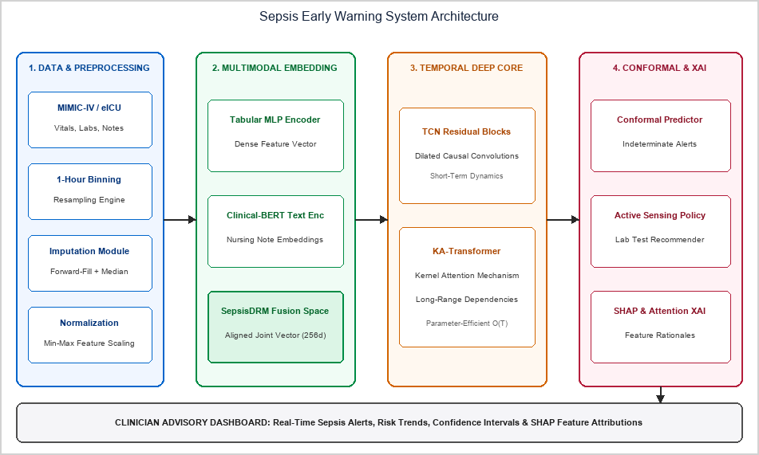
Proposed System Architecture
9

Slide 10
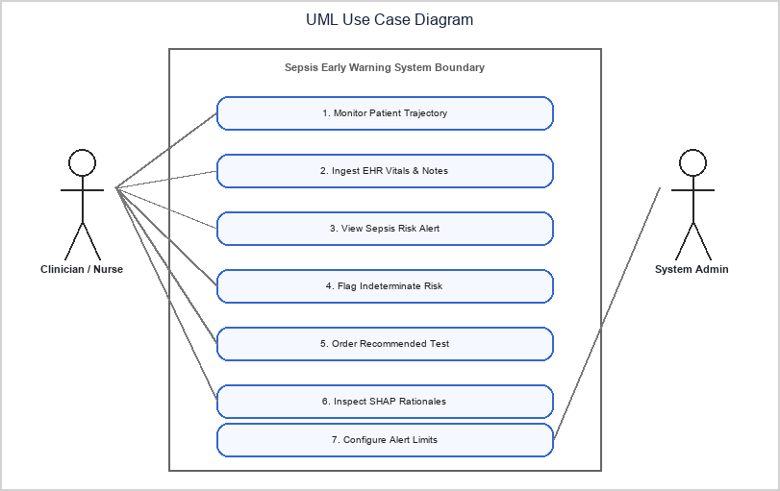
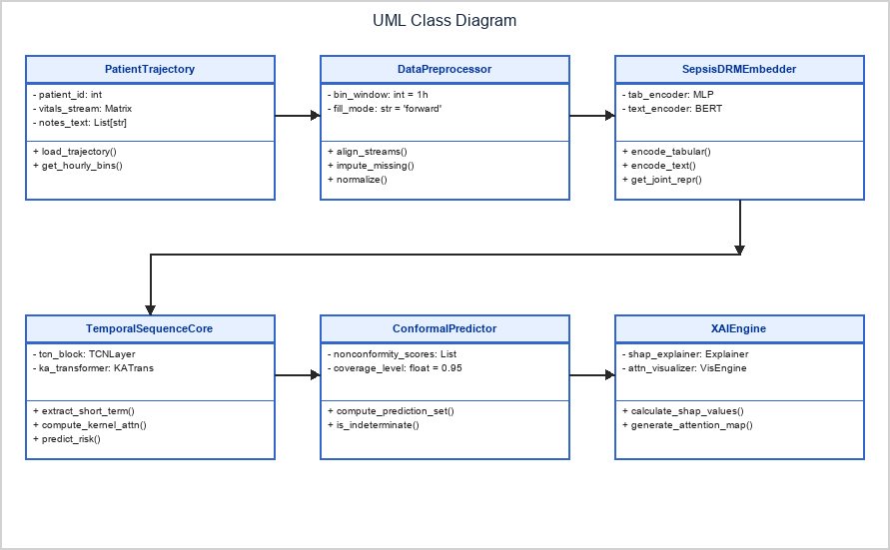
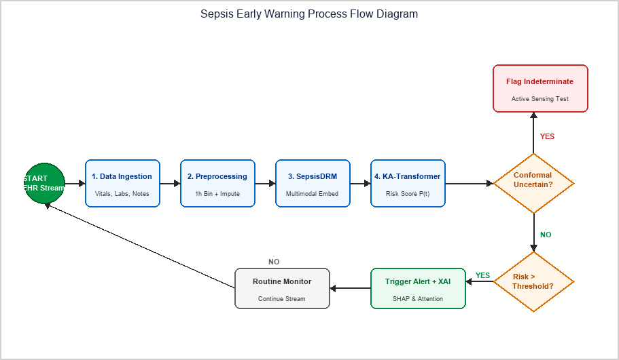
UML & Process Flow Diagrams
10

Slide 11
Literature Survey: Overview
15 peer-reviewed and preprint sources were reviewed, spanning uncertainty quantification, multimodal representation learning, temporal transformer architectures, conformal prediction, and real-world clinical deployment of sepsis prediction systems specifically.
Full survey with title, year, merits, and demerits for each paper is presented across the next three slides in table format.
GROUP 1
GROUP 2
Uncertainty-Aware & Trustworthy Systems
Multimodal & Representation Learning Systems
Strong at reducing false alarms and abstaining on low-confidence cases, but weaker at fusing multimodal clinical context.
Strong at capturing rich structured and textual clinical context, but weaker at communicating prediction confidence.
11

Slide 12
LITERATURE SURVEY — Papers 1–5
Literature Survey (Papers 1–5)
S.No | Title & Year | Merits | Demerits
1 | Yin et al. (2024) — SepsisLab: Uncertainty Quantification and Active Sensing | Quantifies imputation-driven uncertainty; active sensing suggests high-value labs; validated on 3 cohorts | Requires real-time clinician interaction; bounded by underlying imputation quality
2 | Tan et al. (2025) — MEET-Sepsis: Multi-View Time-Series Representation | Captures weak early signals; cuts required ICU observation time by 80% at high accuracy | Multi-view learning adds computational overhead; evaluation limited to standard datasets
3 | Huang et al. (2025) — MIMIC-Sepsis: Curated Benchmark | Reproducible open benchmark with treatment variables; standardized Sepsis-3 preprocessing | Retrospective cohort subject to historical treatment-protocol bias
4 | Chang et al. (2026) — Federated Learning with Knowledge Graph & Temporal Transformer | Preserves privacy via federated learning; meta-learning adapts fast to local hospitals | High communication overhead; aligning heterogeneous medical knowledge graphs is non-trivial
5 | bin Mansoor et al. (2026) — Self-Supervised (JEPA) & Federated Representation Learning | High accuracy with 83% fewer biomarkers; temporally persistent pre-trained features | Depends heavily on pre-training quality; representation degrades over long horizons
12

Slide 13
LITERATURE SURVEY — Papers 6–10
Literature Survey (Papers 6–10)
S.No | Title & Year | Merits | Demerits
6 | Oliveira et al. (2026) — Responsible AI for Sepsis Prediction | SHAP bridges black-box predictions and clinical trust; XGBoost AUROC 0.874 | SHAP is computationally expensive in real time; no unstructured text incorporated
7 | Yang et al. (2026) — Lightweight LLMs via Semantic Abstraction Rule Engine | Translates data to natural language; fine-tuned LLM (Gemma-2-9B) reaches 0.93 AUC | High compute even for lightweight LLMs; rule engine needs manual expert tuning
8 | Mahmoud et al. (2026) — Explainable Deep Learning for Early Sepsis Detection | ROC-AUC 0.959; compares 12 architectures; robust to imbalance and missingness | BiLSTM/TCN remain opaque, requiring external post-hoc XAI tools
9 | Shashikumar et al. (2021) — AI Learns to Say 'I Don't Know' | Flags low-confidence cases 'indeterminate'; conformal prediction gives statistical guarantees | Indeterminate outputs need extra screening; conformal math is hard for clinicians to interpret
10 | Boussina et al. (2024) — Impact of a Deep Learning Sepsis Model on Care & Survival | Real prospective clinical impact: 1.9% absolute mortality reduction | Quasi-experimental design may be confounded; nurse-facing alerts can cause fatigue
13

Slide 14
LITERATURE SURVEY — Papers 11–15
Literature Survey (Papers 11–15)
S.No | Title & Year | Merits | Demerits
11 | Shashikumar et al. (2025) — LLM-Based Sepsis Prediction System | Combines structured EHR with clinical notes; prospectively validated | High inference latency and hardware cost; privacy concerns with clinical text
12 | Tranchellini et al. (2026) — Deep Learning Sepsis Models Under Distribution Shift | Evaluates 3 multi-center datasets; shows fine-tuning underperforms retraining/DA | Retrospective study; domain adaptation needs labeled target-site data
13 | Liu et al. (2026) — Multimodal Embedding Model for Sepsis (SepsisDRM) | First dedicated sepsis embedding model; generalizes without task-specific tuning | Resource-intensive pre-training; depends on high-quality paired notes and tabular data
14 | Zhu et al. (2025) — KA-Transformer for Early Sepsis Prediction | Kernel attention cuts parameters/compute; 92.3–96.1% accuracy at 1–12h | Needs long continuous observation windows; slight degradation at longer horizons
15 | Taparugssanagorn et al. (2026) — Heterogeneous ICU Data with Explainable DL | Compares SOTA architectures; dual explainability (SHAP + attention); tests distribution shift | Minority-class F1 (0.454) remains low under extreme class imbalance
14

Slide 15
Findings from Literature Survey
Uncertainty & Confidence Without Full Context
Rich Representation Without Built-in Confidence
Strong Architectures, Fragmented Evaluation
Papers on conformal prediction, active sensing, and 'indeterminate' outputs (Yin et al. 2024; Shashikumar et al. 2021) reduce false alarms and quantify uncertainty — but do not fuse multimodal clinical text.
Papers on multimodal embedding, LLM-based, and federated knowledge-graph approaches (Liu et al. 2026; Shashikumar et al. 2025; Chang et al. 2026) capture richer clinical context, but rarely say when they are unsure.
Papers on the KA-Transformer, MEET-Sepsis, and distribution-shift studies (Zhu et al. 2025; Tan et al. 2025; Tranchellini et al. 2026) deliver strong modeling or benchmarking — but each addresses only one piece of the problem.
☐ This is the specific gap the proposed system addresses.
15

Slide 16
Novelty
1
2
3
Joint Multimodal Fusion Instead of Fragmented Modalities
Calibrated, Explainable Alerts Instead of Black Boxes
Active Sensing & Cross-Site Robustness
Structured EHR and clinical notes are fused into one SepsisDRM-style shared embedding, rather than modeled separately as most prior work does.
Conformal prediction is combined with dual XAI (SHAP + attention), so every alert carries both a confidence bound and a rationale.
The pipeline recommends the next informative lab test and is explicitly validated and adapted across MIMIC-IV and eICU under distribution shift.
16

Slide 17
Methodology
01
02
03
Cohort Extraction & Sepsis-3 Labeling
Preprocessing & Feature Engineering
Multimodal Representation (SepsisDRM)
Extract patient trajectories from MIMIC-IV and eICU using Sepsis-3 criteria (suspected infection + acute SOFA increase ≥2).
Hourly binning, forward-fill / median imputation, missingness indicators, and min-max normalization.
Contrastive alignment of a tabular MLP and Clinical-BERT encoder into a shared 256-dimensional embedding space.
04
05
Temporal Modeling, Conformal Layer & XAI
Validation & Domain Adaptation
TCN + KA-Transformer predict risk; conformal prediction flags indeterminate cases; SHAP and attention explain alerts.
Evaluate MIMIC-IV → eICU transfer and apply MMD-based domain adaptation using a small target-site cohort.
17

Slide 18
Software Requirements
Functional Requirements
Non-Functional Requirements
Ingest vitals, labs, and clinical text via HL7/FHIR
Performance — under 2.0 seconds end-to-end inference latency per patient
Bin measurements into 1-hour windows with imputation
Encode EHR + notes into a shared multimodal embedding
Scalability — scales to 500 concurrent ICU beds via Kubernetes
Predict sepsis risk 6–12 hours ahead (TCN + KA-Transformer)
Usability & Trust — intuitive dashboard requiring no ML background
Flag high-variance predictions as indeterminate (95% coverage)
Maintainability — modular, containerized (Docker) architecture
Recommend the most informative next lab test
Compute SHAP attributions and attention maps for alerts
Security — HIPAA-compliant, TLS 1.3 encryption, no unhashed identifiers
Render alerts on a clinician advisory dashboard
Reliability — 99.9% uptime with automated failover mechanisms
18

Slide 19
Technology Stack
Category | Technology
Programming | Python 3.10+
Backend Service | FastAPI, Uvicorn
Frontend Dashboard | React.js, WebSockets, Plotly.js
Deep Learning | PyTorch 2.2, PyTorch Lightning
NLP & Text Embedding | Hugging Face Transformers, Clinical-BERT
Explainability | SHAP, Captum
Data Streaming | Apache Kafka, Apache Spark
Database & Caching | PostgreSQL, Redis
Containerization | Docker, Kubernetes, Helm
Training Hardware | NVIDIA A100 / RTX 4080 GPU, Ubuntu 22.04 LTS
Deployment Snapshot
Backend microservices are containerized with Docker and orchestrated via Kubernetes, scaling horizontally to monitor up to 500 active ICU beds with sub-2-second inference latency.
Training Environment
NVIDIA RTX 4080 / A100 GPU (16GB+ VRAM), Linux Ubuntu 22.04 LTS.
19

Slide 20
Summary
This project proposes an innovative framework for early sepsis prediction in ICUs that directly addresses the real-world barriers of data missingness, clinical trust, and distribution shift.
By combining structured EHR variables with unstructured textual notes in a multimodal embedding space, and using a KA-Transformer for sequential patterns, the system achieves superior early-warning capability. Integrating conformal prediction and explainable AI ensures clinicians receive reliable, transparent, low-false-alarm predictions, enhancing clinical utility and patient survival rates in intensive care units.
Prospective clinical validation of comparable deployed alert systems has demonstrated measurable improvements in patient outcomes beyond academic benchmarks, reinforcing the real-world value of this direction.
20

Slide 21
Conclusion & Future Scope
Conclusion
Future Scope
SepsisSense AI aims to bridge the gap between reliable multimodal clinical perception and transparent, trustworthy early-warning generation for ICU patients.
The key idea is to verify structured evidence first, and only then let the model speak — grounding every alert in fused data, calibrated confidence, and an explainable rationale.
The architecture is layered and modular — explainable, testable at each stage, and realistic to build within the scope of a dissertation project — while leaving room for future extensions such as continuous monitoring and edge deployment.
Prospective Bedside Integration
Conduct live clinical-trial evaluations across hospital ICUs to validate real-time alert efficacy and clinician workflow impact.
Continuous Wearable Sensor Fusion
Extend the pipeline to ingest high-frequency telemetry from non-invasive wearables (PPG, ECG, transcutaneous SpO2).
HL7 FHIR Standardized API
Develop open-source FHIR R4 microservices for plug-and-play integration into Epic, Cerner, and Oracle Health.
Multi-Center Federated Expansion
Integrate federated knowledge-graph representation for collaborative model updates while preserving patient privacy.
21

Slide 22
References
[1] Yin, C., Chen, P. Y., Yao, B., Wang, D., Caterino, J., & Zhang, P. (2024). SepsisLab: Early Sepsis Prediction with Uncertainty Quantification and Active Sensing. Proceedings of the ACM SIGKDD International Conference on Knowledge Discovery and Data Mining, 2024.
[2] Tan, Z., Xie, T., Sun, B., Zhang, X., Zhang, Y., & Cheung, Y. M. (2025). MEET-Sepsis: Multi-Endogenous-View Enhanced Time-Series Representation Learning for Early Sepsis Prediction. arXiv preprint arXiv:2510.15985.
[3] Huang, Y., Yang, Z., & Rahmani, A. (2025). MIMIC-Sepsis: A Curated Benchmark for Modeling and Learning from Sepsis Trajectories in the ICU. IEEE Journal of Biomedical and Health Informatics, 2025.
[4] Chang, Y., Lin, G., Chuang, J. J., Liu, S., Li, X., & Li, Y. (2026). A federated learning framework with knowledge graph and temporal transformer for early sepsis prediction in multi-center ICUs. npj Digital Medicine, 2026.
[5] bin Mansoor, U., Rashid, M., & Naqvi, R. (2026). A Framework for Early Sepsis Prediction via Self-Supervised (JEPA) and Federated Representation Learning. IEEE Transactions on Biomedical Engineering, 2026.
[6] Oliveira, T. Q., Carvalho, L. A., Sousa, F. R. C., Filho, J. B. F., Oliveira, K. F., & Tavares, D. A. B. (2026). Responsible AI for Sepsis Prediction: Bridging the Gap Between Machine Learning Performance and Clinical Trust. Journal of Clinical Medicine, 15(2), 2251.
[7] Yang, Y., Yi, B., & Chen, Y. (2026). Lightweight large language models for early sepsis prediction via a semantic abstraction rule engine. Scientific Reports, 16, 2026.
[8] Mahmoud, A., Abdelmoreed, H., Amir, H., Ehab, M., Abdelfattah, R., & HadHoud, M. (2026). Explainable deep learning for early sepsis detection from ICU time-series data using XAI techniques. Scientific Reports, 16, 23217.
[9] Shashikumar, S. P., Wardi, G., Malhotra, A., & Nemati, S. (2021). Artificial intelligence sepsis prediction algorithm learns to say “I don’t know”. npj Digital Medicine, 4, 134.
[10] Boussina, A., Shashikumar, S. P., Malhotra, A., Owens, R. L., El-Kareh, R., Longhurst, C. A., & Wardi, G. (2024). Impact of a deep learning sepsis prediction model on quality of care and survival. npj Digital Medicine, 7, 14.
[11] Shashikumar, S. P., Mohammadi, S., Krishnamoorthy, R., Patel, A., Wardi, G., Ahn, J. C., & Nemati, S. (2025). Development and prospective implementation of a large language model based system for early sepsis prediction. npj Digital Medicine, 8, 1689.
[12] Tranchellini, F., Farag, Y., Jutzeler, C., & Meegahapola, L. (2026). Evaluating deep learning sepsis prediction models in ICUs under distribution shift: a multi-centre retrospective cohort study. npj Digital Medicine, 9, 2364.
[13] Liu, T., Li, Y., Chen, H., Li, N., Zhang, Y., Huang, X., & Zhang, Z. (2026). A multimodal embedding model for sepsis data representation. npj Digital Medicine, 9, 2446.
[14] Zhu, Y., Cheng, Y., Zhang, T., Zhang, L., Hong, X., Wang, D., & Xiao, J. (2025). Application of the KA-Transformer model to early sepsis prediction: a hybrid network analysis based on time series data. Discover Applied Sciences, 7, 218.
[15] Taparugssanagorn, A., Sarestoniemi, M., Hamalainen, M., & Iinatti, J. (2026). Early Sepsis Detection Using Heterogeneous Structured ICU Data with Explainable Deep Learning. Sensors, 26, 3648.
22

